Slide 1
About Blacksburg Transit
Started in 1983
Grown from 8 buses to 46
Grown from 3 routes to 12
Operator staff has increased from 26 part-time operators to 84 part-time and seven full-time operators
The original staff consisted of a contracted Transit Manager, three full-time supervisors and one part-time accounting clerk.
Provides complementary paratransit service via BT ACCESS

Slide 2
TIGGER Open House
November 15, 2013

Slide 3
Operations
Types of Service include: Fixed, Deviated-Fixed and Demand Response
46 buses in the fleet
Provides 3.5 million passenger trips per year
90% Students; 5% Staff & Faculty; 5% Non-VT

Slide 4
What is ITS?
The use of advanced applications which, without embodying intelligence as such, aim to provide innovative services relating to different modes of transport and traffic management and enable various users to be better informed and make safer, more coordinated and “smarter” use of transport networks.

Slide 5
TIGGER Grant Overview
TIGGER – Transit Investment in Greenhouse Gas and Energy Reduction
BT received a $1.85 million grant from DOT and FTA to conduct a study.
BT and VTTI are partnering to complete this study on the effects of Dynamic Bus Routing and Scheduling to conserve fuel and provide better customer service.

Slide 6
What is the TIGGER Grant?
Collect data at stop-level to build a better picture of demand in close to real-time.
Proactive vs. Reactive
    Will be able to predict when additional buses will be needed before the need arises.

Slide 7
Project Scope
Project Planning – develop schedule, routing model development and implementation.
Data collection – evaluation and selection of methods and hardware for data collection.
  Develop specs for equipment
  Procure equipment
  Install
  Design software applications
  Collect data

Slide 8
Project Scope Cont’d
Data analysis and modeling algorithm development
Model calibration and finalization – to be tested during pilot implementation
Implementation and testing of the routing/scheduling plan
Pilot implementation
Revisions of optimization model
System-wide implementation

Slide 9
Reason for Study
To see if it is possible to use dynamic routing to:
Reduce CO2 gases/fuel usage
Enable a more efficient transit system
Increase customer satisfaction

Slide 10
Objectives
Use a test route to collect real-time passenger data
Use data to create a communication path for customers and buses
Have buses only being used when there is a need (to cut down on Trippers and empty buses).
Reinventing Transit Operations
Making a Greener Planet
Cutting Edge National Research

Slide 11
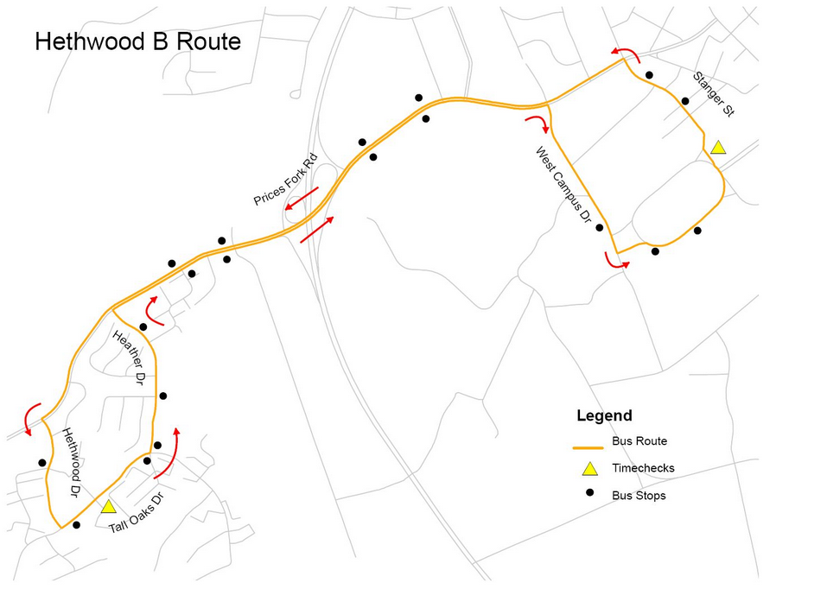
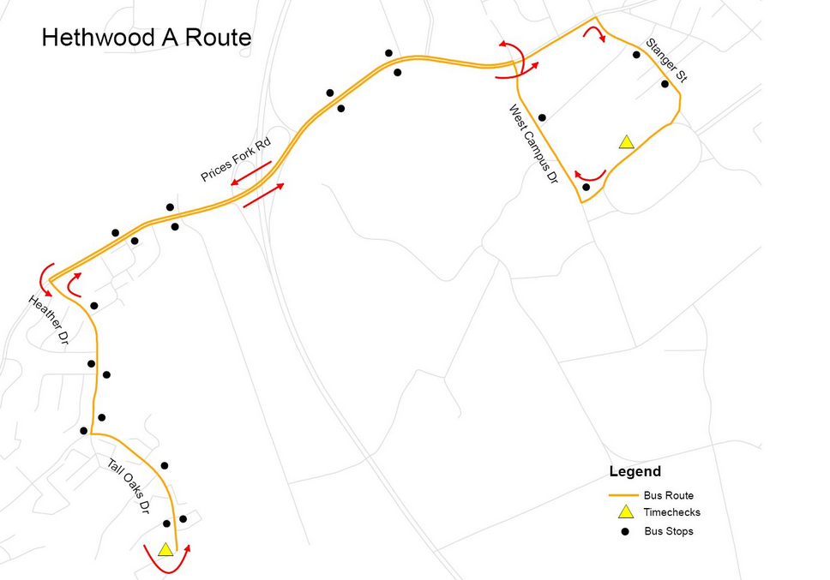
Map of Tested Area

Slide 12
What is BT4U?
BT4U is BT’s new text messaging program that allows bus customers to use their cell phone to receive up to the next three scheduled departure times for an individual stop.
          Phone
          Web
          Text

Slide 13
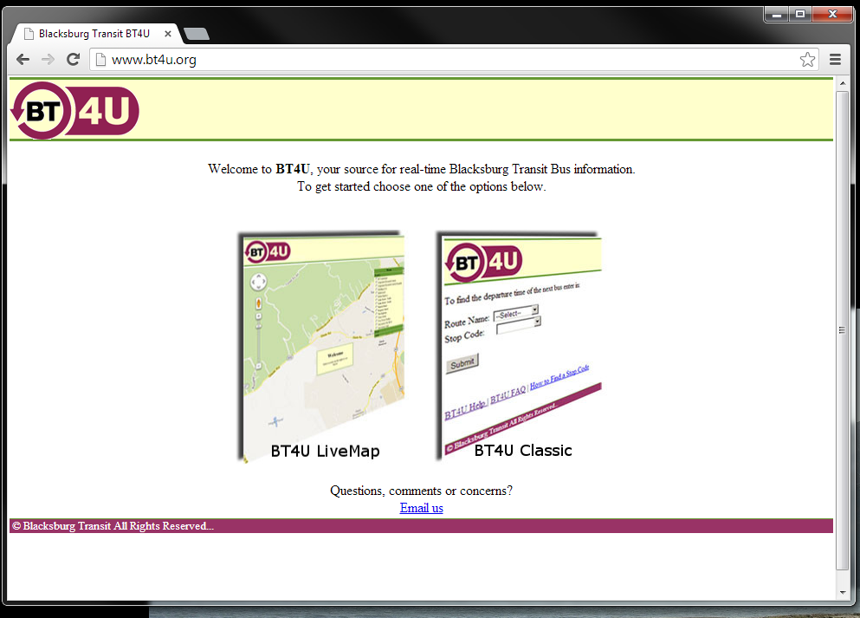

Slide 14
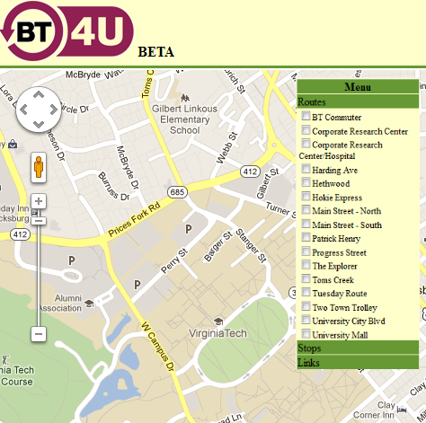

Live Map
Select your route

Slide 15
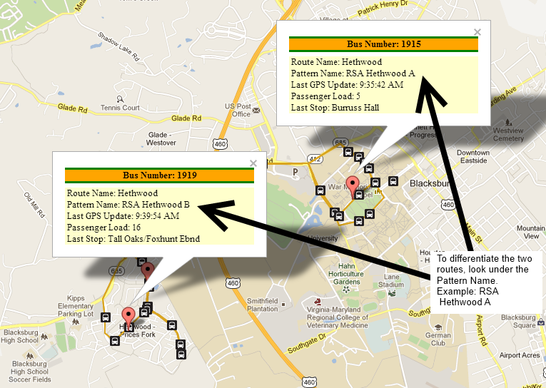
Live Map

Slide 16
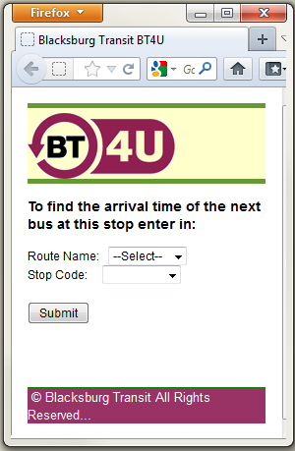
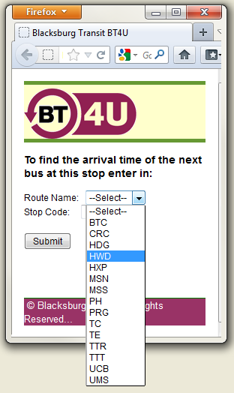
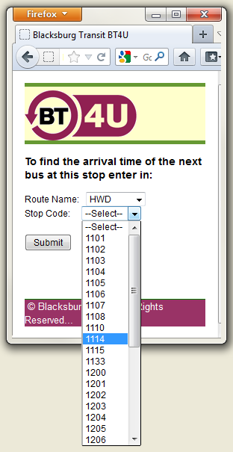
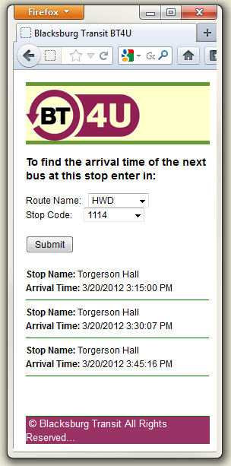
BT4U Classic

Slide 17
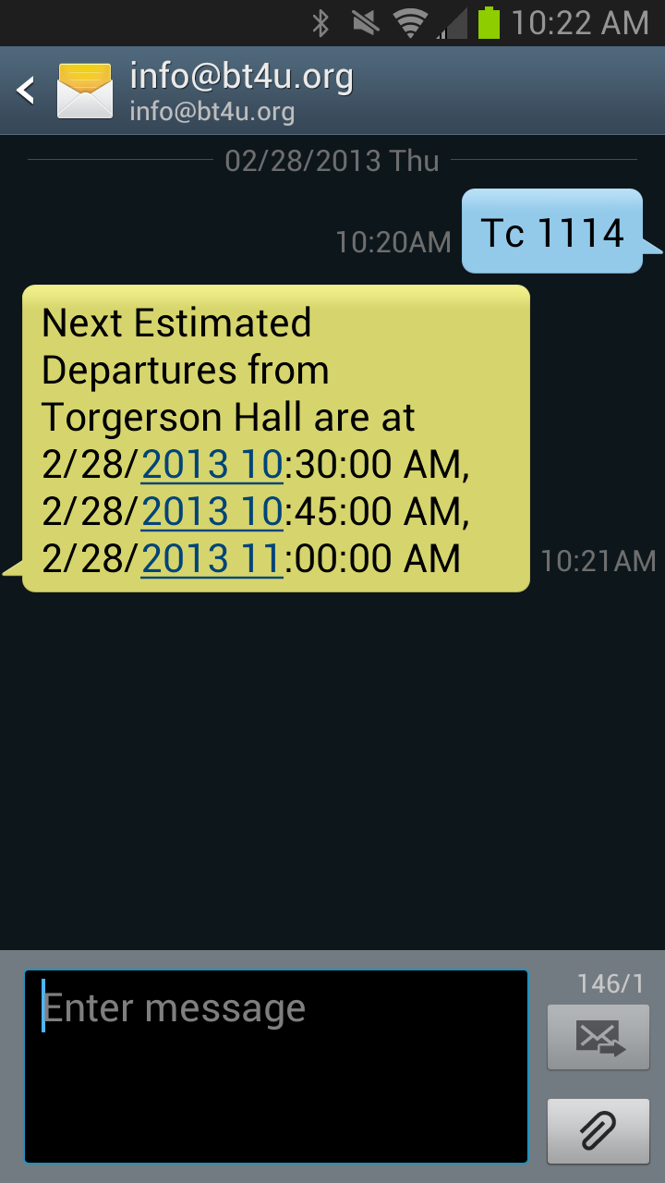
BT4U Text
Users send a text message with the stop code and number and receive up to the next 3 departure times.

